Slide 1
Red List of Bangladesh

Slide 2
Red List of Threatened Animals
In 1964, the IUCN (International Union for Conservation of Nature) Red List of Threatened Species has been successfully established as a powerful conservation tool.
Its goal is to provide information and analyses on the status, trends and threats to species.
World’s most comprehensive information source on the extinction risk of species.

Slide 3
IUCN Bangladesh had published the first Red List of Threatened Animals of Bangladesh in 2000 where a total of 266 species of freshwater fishes were assessed and among these, 54 species were considered as Threatened. Among the assessed fishes, 12 species were Critically Endangered (CR), 28 species Endangered (EN), 14 species Vulnerable (VU), 66 species Data Deficient (DD) and the rest 146 species were considered Not Threatened (NO).
In 2015, 253 Freshwater Fishes were assessed. Threatened Categories are concerned nearly one fourth (64 species) of the species are under threat, among them 9 Critically Endangered, 30 Endangered, and 25 Vulnerable. This has been followed by 27 species as Near Threatened. There are 122 species that were assessed as Least Concern and rest of the 40 as Data Deficient.

Slide 4
Red List Assessment Tools
Two major tools applied during the assessment process----
1. ‘IUCN Red List Categories and Criteria Version 3.1 (IUCN 2012)’ and
2.‘Guidelines for Application of IUCN Red List Criteria at Regional and National Levels Version 4.0 (IUCN 2012)’.
prepared by IUCN Species Survival Commission (SSC).

Slide 5
Red List Assessment Tools
A species assessment sheet designed by the IUCN Red List Unit was used for assessing an individual taxon.
GIS software was used to assess the distribution of the taxon.
All species have given a Species Identification Number i.e. SID
Resource materials collected and preserved in IUCN Bangladesh Country Office to be managed in the future by the IUCN itself or the Bangladesh Forest Department.

Slide 6
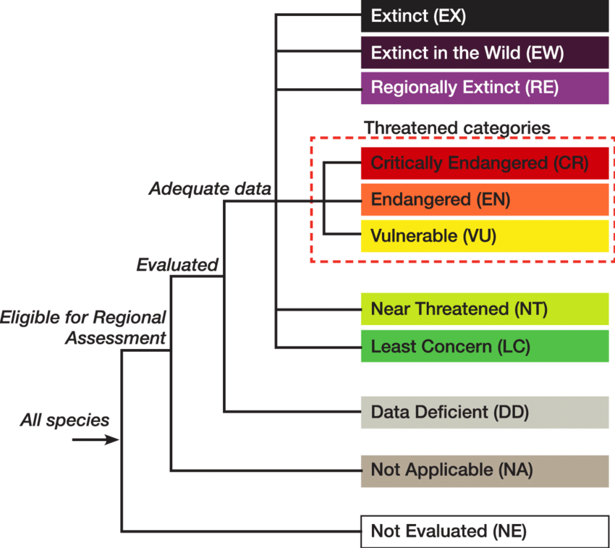
The IUCN Red list Categories

Slide 7
Categories
EXTINCT (EX):
A taxon is Extinct when there is no reasonable doubt that the last individual has died.
EXTINCT IN THE WILD (EW)
A taxon is Extinct in the Wild when it is known only to survive in cultivation, in captivity or as a naturalized population (or populations) well outside the past range.
REGIONALLY EXTINCT (RE)
Category for a taxon when there is no reasonable doubt that the last individual potentially capable of reproduction within the region has died or has disappeared from the wild in the region.

Slide 8
CRITICALLY ENDANGERED (CR)
A taxon is Critically Endangered when it is therefore considered to be facing an extremely high risk of extinction in the wild.
Labeo boga (Bhangan, Bhangan Bata)
Labeo nandina (Nandil, Nandi, Nandina)
Tor tor (Mohashol, Mohsheer)
Channa barca (Pipla, Pipla Shol, Tila Shol)
Ompok pabo (Pabda, Kala Pabda)
.

Slide 9
ENDANGERED (EN)
A taxon is Endangered when it is therefore considered to be facing a very high risk of extinction in the wild.
Pangasius pangasius (Pangas)
Ompok pabda (Madhu pabda, Pabda, Paibba)
Ompok bimaculatus (Kani Pabda, Boali Pabda)
Rita rita (Rita, Rida)
Channa marulius (Gajar, Gajal, Sal, Gajori )
Chitala chitala (Chital, Chitna)
Botia Dario (Rani Mach, Bou Mach)

Slide 10
VULNERABLE (VU)
A taxon is Vulnerable when it is therefore considered to be facing a high risk of extinction in the wild.
Gudusia chapra (Chapila, Chaipla, Suiya)
Chela cachius (Chhep chela)
Labeo ariza (Lasso, Raik, Bata)
Labeo boggut (Ghonia, Paharia Maach)
Notopterus notopterus ( Foli, Haila, Kanla)

Slide 11
NEAR THREATENED (NT)
A taxon is Near Threatened when it has been evaluated against the criteria but does not qualify for Critically Endangered, Endangered or Vulnerable now, but is close to qualifying for or is likely to qualify for a threatened category in the near future.
Cirrhinus cirrhosus (Mrigal, Mirka, Mahal, Malmuch)
Cirrhinus reba (Bhanga, Tatkini, Bata, Laccho)
Labeo gonius (Gonia, Ghannia,Goni, Kurchi)
Nandus nandus (Bheda, Meni, Roina, Nandui)
Badis badis (Naptey Koi, Napit Koi, Kala Koi)
Mystus gulio (Nuna-tengra/ Guillya/ Penchgula)

Slide 12
LEAST CONCERN (LC)
A taxon is Least Concern when it has been evaluated against the criteria and does not qualify for Critically Endangered, Endangered, Vulnerable or Near Threatened. Widespread and abundant taxa are included in this category.
Hilsa kelee (Gurta Ilish)
Tenualosa ilisha (Ilish, Ilsha)
Tenualosa toli (Chandana Ilish)
Setipinna phasa (Phasa, Phasa Kata, Tel-tampori )
Catla catla (Catla, Kato)
Labeo bata ( Bata, Bhangon Bata )
Labeo calbasu (Kalibaos, Baus)
Labeo rohita (Rui, Rohit, Ruee)

Slide 13
DATA DEFICIENT (DD)
A taxon is Data Deficient when there is inadequate information to make a direct, or indirect, assessment of its risk of extinction based on its distribution and/or population status.
NOT EVALUATED (NE)
A taxon is Not Evaluated when it has not yet been evaluated against the criteria.
NOT APPLICABLE (NA)
Category for a taxon deemed to be ineligible for assessment at a regional level. A taxon may be NA because it is not a wild population or not within its natural range in the region, or because it is a vagrant to the region. It may also be NA because it occurs at very low numbers in the region or the taxon may be classified at a lower taxonomic level than considered eligible by the regional Red List authority.

Slide 14
Key Roles of the Red List in Conservation
Threat Assessment:
The Red List categorizes species into threat levels (e.g., Vulnerable, Endangered, Critically Endangered) based on globally accepted criteria, providing a clear indication of their extinction risk.
Prioritization:
It helps identify which species and ecosystems are most in danger, allowing conservation organizations and governments to focus limited resources on the most critical threats.
Informing Policy and Planning:
National and regional Red Lists provide crucial data for developing and implementing conservation strategies, policies, and action plans.

Slide 15
Key Roles of the Red List in Conservation
Measuring Progress:
The Red List allows countries to measure and report on their progress towards international biodiversity commitments, such as those under the Convention on Biological Diversity.
Guiding Conservation Actions:
The detailed information on species' distributions, threats, and ecological needs provided by the Red List supports the planning and implementation of recovery and conservation efforts.
Raising Awareness:
By highlighting threatened species and the health of the planet's biodiversity, the Red List serves as a powerful communication tool, educating the public and decision-makers about the importance of conservation.
Barometer of Life:
The Red List aims to be a "barometer of life," providing a crucial status update on the health of the world's species and ecosystems.

